Slide 1



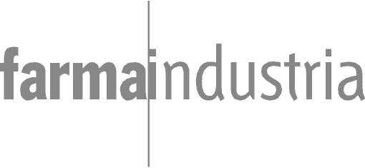
XXI Encuentro de Cooperación Farma-Biotech
17 de noviembre de 2021
Platform of polymeric glycoconjugates for removing harmful antibodies (HART-Technology)
Dr. Rafael Mañez

Slide 2


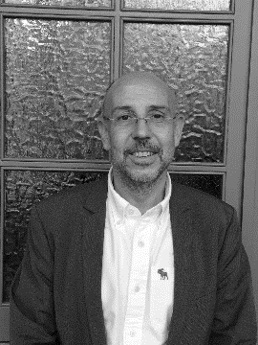



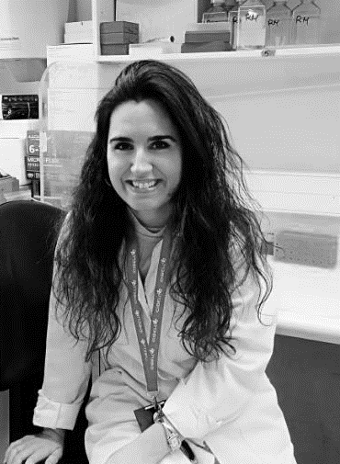
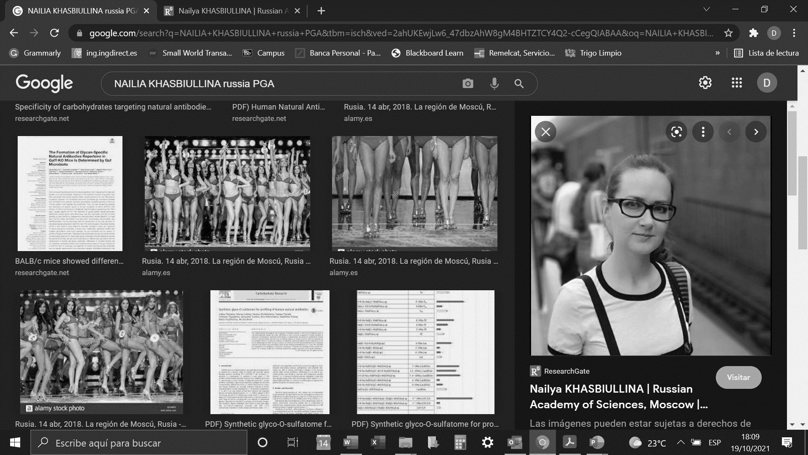







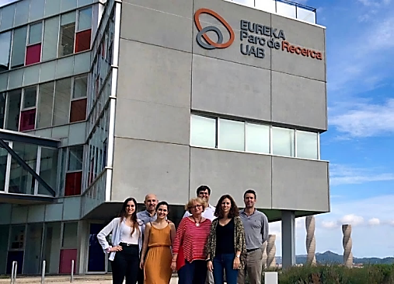



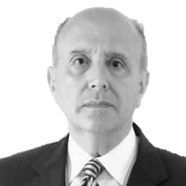
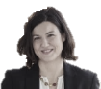


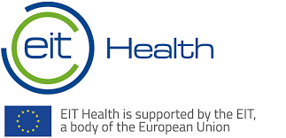








Pablo Madrazo
Co-founder, CEO
Montserrat Tarres
CCO
Rafael Mañez
Co-founder, President
& CMO
Daniel Bello
Co-founder, CSO
Sara Olivera
Project Manager
Anna Crespo
PostDoc Researcher
Yara Ferrero
Technician
Nailia Khasbiullina
PostDoc Researcher
CONSULTANTS
Regulatory
SCIENTIFIC ADVISORY BOARD
Christopher Mann
Xavier Lluria
Eduardo Cunchillos
David López
Uri Galili
US
anti-αGal Abs
Nicolai Bovin,
Russia
Glycomics
Rafael Cantón
Spain
AMR
Bus.
Develop.
CMC
IP
Legal
Bonaventura Clotet
Spain
Infectious Diseases
Suresh Mahalingam Australia
ADE of infection
Xavier Berthet
José Luis Fábregas
Silvia Beltrán
Oscar
Alegre

Slide 3
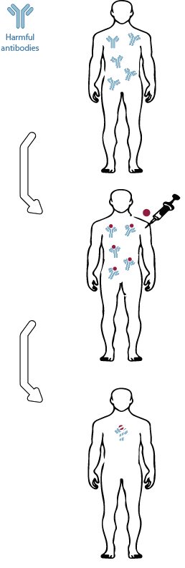
HARMFUL ANTIBODY REMOVAL TECHNOLOGY (HART ™)
HOW HART ™ WORKS:
Harmful
Antibody
STEP
1
Presence of harmful antibodies
Adverse circulating antibodies, causing a deleterious immune response. These antibodies mediate many human diseases and can be involved in the onset and/or progression of the pathology.
Novel
Glycoconjugate
PIPELINE: PLATFORM OF POLYMERIC GLYCOCONJUGATES
STEP
2
Administration of glycoconjugate
To specifically deplete this deleterious antibody population, RemAb develops specific glycoconjugates that, once injected parenterally, bind adverse antibodies. Immunocomplexes are quickly metabolized and excreted through the urine.
STEP
3
Clearance of immunocomplexes
Rapid clearance of immune complexes translates into clinical benefits for the patients, ranging from prevention of infections to reduction of disease severity.

Slide 4
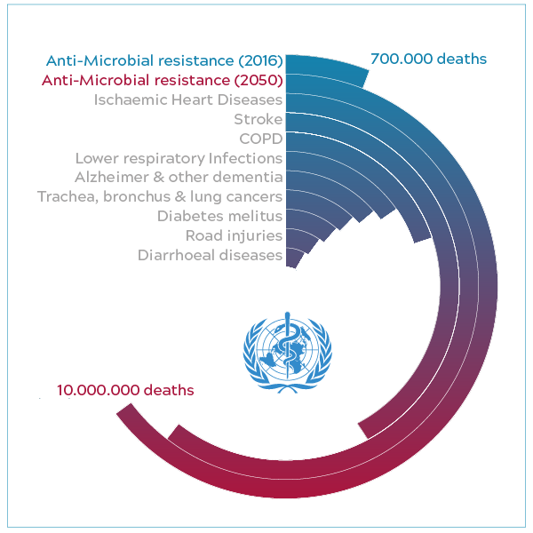


PROGRAM RA0127: PROBLEM OVERVIEW
Antimicrobial resistance (AMR)
700,000 deaths
Intensive Care Units (ICU):
The epicentre of the problem
20%
10%
of all nosocomial infections are acquired in ICUs. Mainly caused by gram-negative bacteria
of the infections are invasive (pneumonia or bacteriemia)
10,000,000 deaths
100 billion Euro
80%
50%
Review on Antimicrobial Resistance, May 2016
Tackling antimicrobial resistance (AMR) together (2018).
The Need for a One Health – One Europe – One World Framework (2016)
of the patients receive antibiotics against gram-negative infections
are resistant to multiple drugs. No fully effective treatment
Antibody-Dependent Enhancement
(ADE) of Infection
35%
40%
of patients admitted to ICU will develop an infection
Of ICU expenditure are linked to bacterial infections and sepsis
Intensive care units as epicentres for antimicrobial resistance development.
Surveillance of antimicrobial resistance in Europe 2018
A randomized placebo-controlled phase II study of a Pseudomonas vaccine in ventilated ICU patients
Human natural anti-Gal IgG regulates alternative complement pathway activation on bacterial surfaces (1992)
Natural antibodies in normal human serum inhibit Staphylococcus aureus capsular polysaccharide vaccine efficacy (2012)
Increased severity of respiratory infections associated with elevated anti-LPS IgG2 which inhibits serum bactericidal killing (2014)
Antibody-Dependent Enhancement of Bacterial Disease: Prevalence, Mechanisms, and Treatment (2021)

Slide 5





PROGRAM RA0127: SOLUTION
RA0127: First-in-Class injectable drug for the prevention of ICU-acquired bacterial infections
Target: inhibitory anti-αgalactosyl (αGal) antibodies, which facilitate Gram-negative infections
Mechanism of action: specific intracorporeal removal of inhibitory anti-αGal antibodies, interfering a mechanism of bacterial pathogenesis
Killing Abs
Inhibitory anti-αgalactosyl (αGal) Abs
RA0127
Gram negative bacteria
WO2016026981, covered by an international granted patent family, FTO in Europe and USA
Initial indication: ICU patients (stays ≥ 7 days)
Synthetic manufacturing, CMC validated at relevant scale (g-kg)
RA0127 fits for public & private hospital markets.
It is a cost-saving alternative

Slide 6
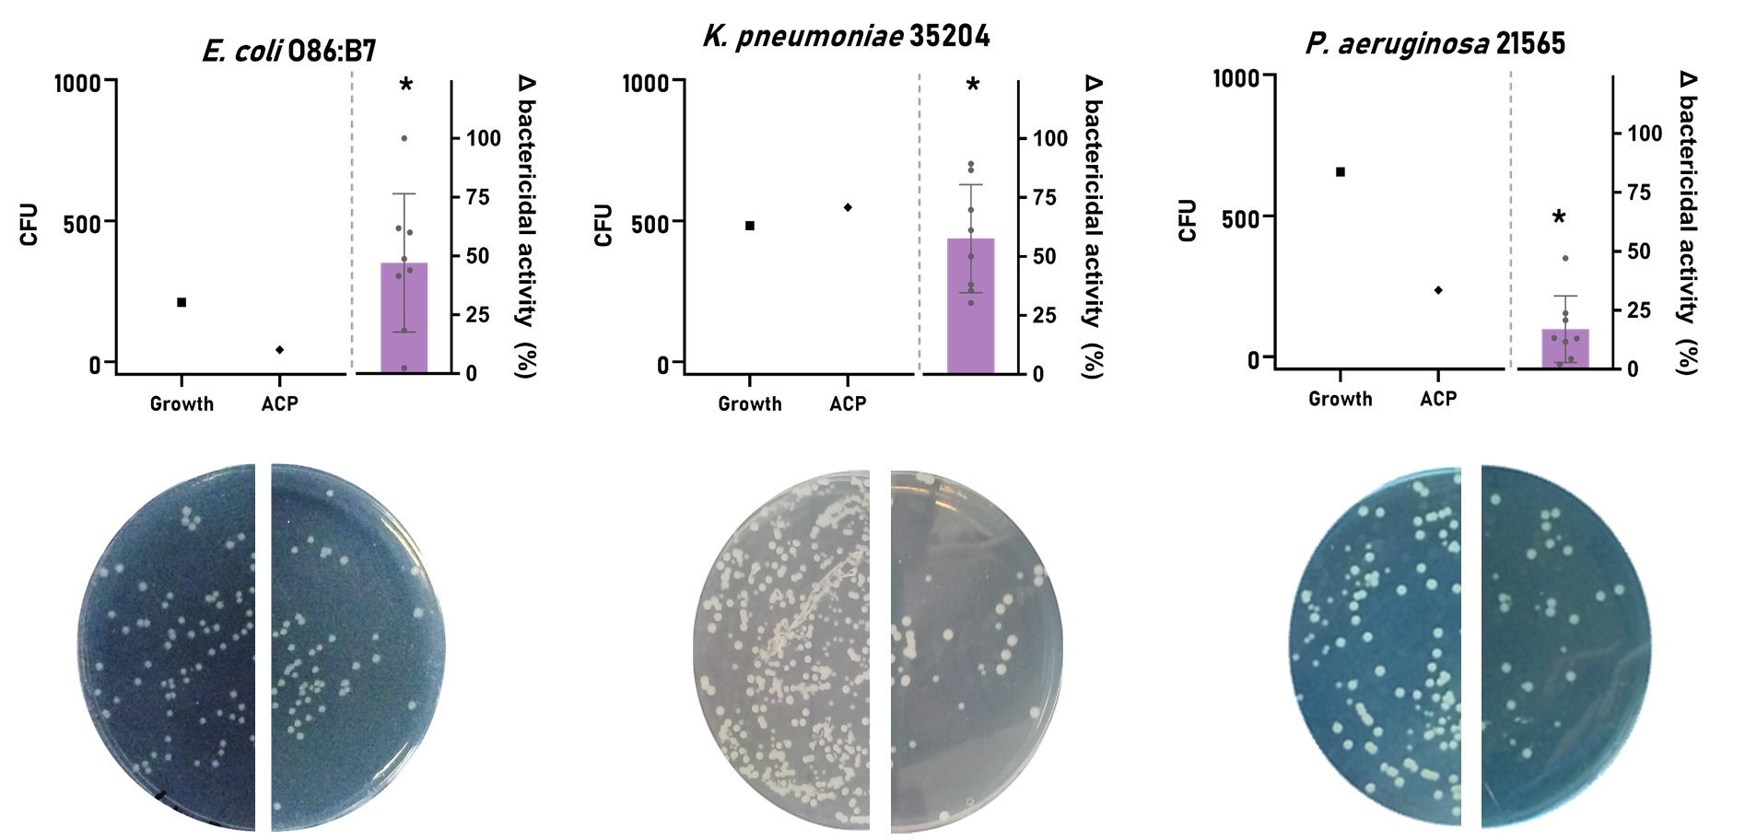
PRECLINICAL IN VITRO VALIDATION (EFFICACY)
RA0127 IMPROVES HUMAN SERUM KILLING CAPACITY VS. GRAM-NEGATIVE (INCLUDING MDR-BUGS)

Slide 7
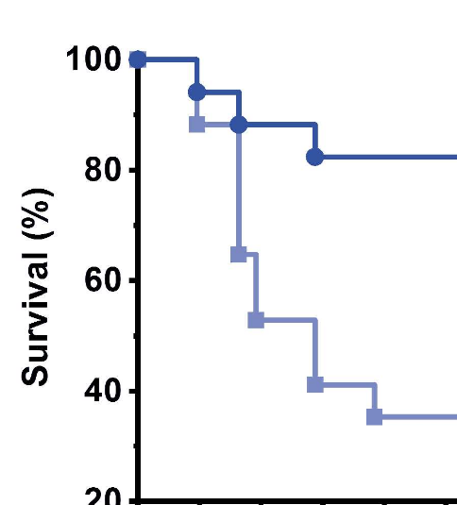
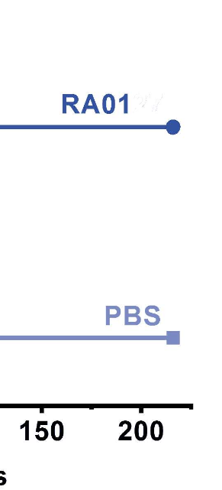
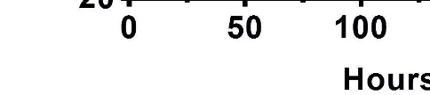
PRECLINICAL IN VIVO VALIDATION (EFFICACY)
RA0127 REDUCES ~ 60% OF MORTALITY IN STANDARIZED MODEL OF SEVERE INFECTION
RA0127
CONTROL
CONTROL
RA0127

Slide 8
PRECLINICAL REGULATORY STUDIES IN CYNOMOLGUS MONKEYS
RA0127 showed and excellent safety profile:
The RA0127 non-clinical safety assessment was based on two 30 min IV infusion studies in monkey (Cynomolgus sp): a MTD and a 4-week repeated dose toxicity studies (completed last July-2021). Efficacy and safety have been evaluated in the same species making the comparison between the two endpoints easier.
MTD:
Phase 1: scaling dose phase (5-15-50 mg/Kg) (n=3).
NO SIGNS OF TOXICITY WERE RECORDED
Phase 2: repeated dose phase
(dosed three times at 50 mg/kg, 48 h apart) (n=4).
NO SIGNS OF TOXICITY WERE NEITHER RECORDED
4-week repeated dose toxicity study: 5-15-50 mg/Kg (dosed three times a week, 48 h apart, for 4 weeks) (n=32).
no signs of adverse toxicity have been recorded. No treatment related findings have been identified.
AUC0-24 and Cmax (50 mg/kg): 15840 μg.h/mL and 958 μg/mL, respectively. While the estimated exposure at the efficacy dose in monkey (1 mg/kg) was 51.8 μg.h/mL and 18.5 μg/mL respectively.
The highest exposure tested in the MTD and 4-week studies without any sign of toxicity was at least 300 times and 50 times higher respectively than this observed at the efficacy dose. Therefore, the in vivo toxicity studies have tested doses which are expected to be at least 50 times the exposure in the proposed first clinical trial with RA0127 as requested by ICH M3.

Slide 9
RA0127 CLINICAL DEVELOPMENT
FIH trial design: to be confirmed by AEMPS next 26th October 2021 (online SA meeting)
Phase 1a: SAD phase in male volunteers (n=8, 4 groups of treatment), four different dose levels (1/3xHEPAD, HEPAD, 1.5xHEPAD and 3xHEPAD), and multiple dose phase in male volunteers at one single dose level (n=8)
Phase 1b: multiple dose phase in ICU patients at one single dose level (n=10)

Slide 10
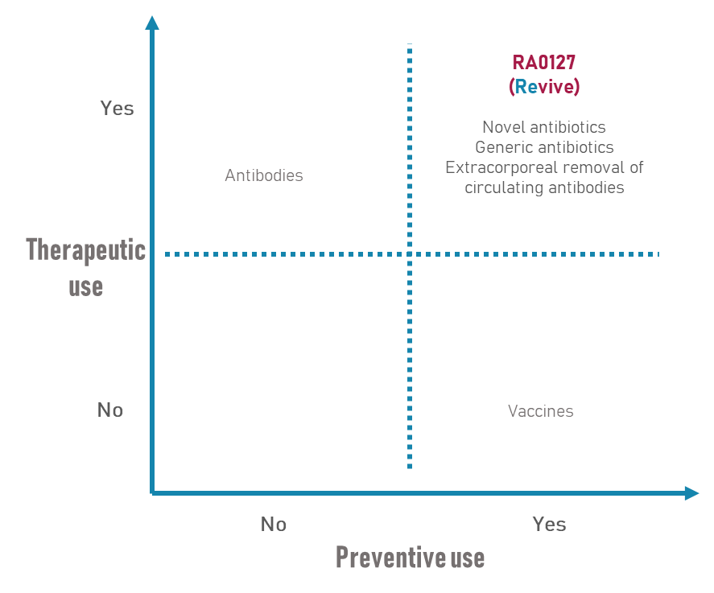
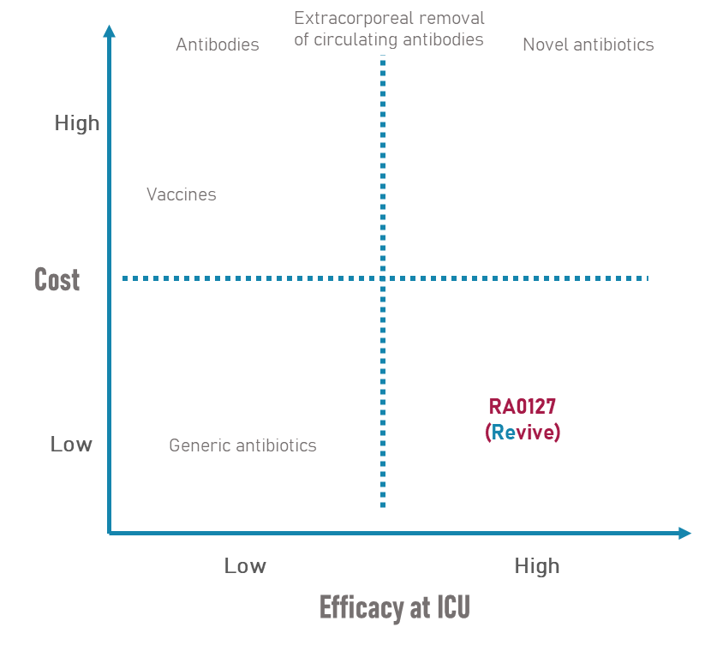
COMPETITIVE LANDSCAPE: RISKS AND OPPORTUNITIES
WEAKNESSES
High risk innovative technology
Relatively young company
Limited financial, and human resources
THREATS
Limited investment in R&D for new antimicrobials
Huge market, with high barriers, to penetrate.
Acceptance of the technology by medical community, decision makers and payers.
Competitors with huge experience and resources.
COVID-19 economic situation crisis
Monoclonal
antibodies
STRENGTHS
Technology and product protected by patent.
Advantages far superior to current solutions.
Promising in vitro/in vivo results.
Competitive prices. Real savings.
Huge scientific know-how of the Company.
Complementary team, highly qualified.
Strategic alliances
Portfolio diversification
OPPORTUNITIES
Growing problem, unmet medical need.
Urgent market need of non-antibiotics novel solutions for superbugs (WHO warnings!)
High political and social awareness
Increasing pull incentives to make drug developments profitable
FDA and EMA are harmonizing procedures to expedite the market authorization of new drugs and allowing more extensive patent exploitation.
Monoclonal
antibodies
Notes:
Incluyo aqui cosas interesantes que he borraod de la slide, pero esta bien guardarselas para el “speech”
Weaknesses 2. (however, with +20 years of experience of its members in the scientific, biomedical, ICU and business fields).
3. (strong board of consultants). 4. (incentives disconnected from net sales).
Threats: 2. Big players (potential RemAb clients).
Opportunities: 3. enhanced by covid19 situation

Slide 11



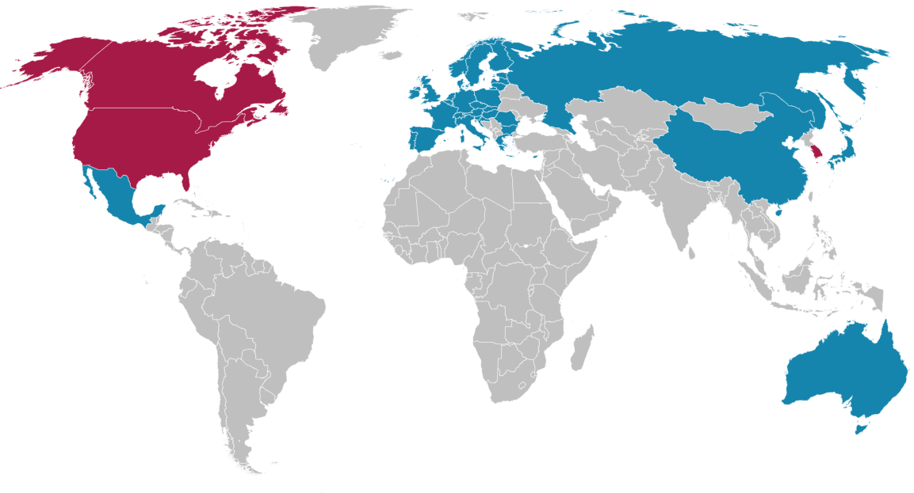





MARKET OPORTUNITY: THERAPEUTIC AND ECONOMIC IMPACT
Total Addressable Market
TAM
16 M patients/year
Serviceable
Available
Market
*average cost of a day at the ICU: 2,250€ From: Direct cost analysis of intensive care unit stay in four European countries: applying a standardized costing methodology (2012)
WO2016026981
RA0127 will have a significant impact on:
Reducing the antibiotic consumption
Preventing antimicrobial resistance
Reducing duration of ICU stays
Making healthcare cost-effective
SAM
Patent granted
4.8 M patients/year
Under examination
Serviceable Obtainable Market
AMR
SOM
€
Notes:
Pendiente por si hay algun cambio en forecast actualizar tabla de SOM

Slide 12
OTHER PROGRAMS AND INDICATIONS
The platform compounds share the core structure of RA0127, demonstrated as not toxic in recent preclinical regulatory studies in monkeys. So, no toxicity is expected for the rest of the indications.
Mechanism of action validated in monkeys (preclinical regulatory studies): safe and immediate intracorporeal removal of selective harmful antibodies.

Slide 13
PARTNERING OPPORTUNITIES
Investment: RemAb is starting this November 15, 2021 an investment round to finance phase 1 (expected initiation 2Q-2022).
Scientific collaboration and partnering in new indications.

